Slide 1

Establishing an inclusive and sustainable design program for assistive technology
Joe Lawler, Alyssa Spomer, Keshia Peters, Katherine Steele
CSNE Research Symposium 2018
Ability & Innovation Lab, Mechanical Engineering, University of Washington, Seattle, WA USA

Slide 2
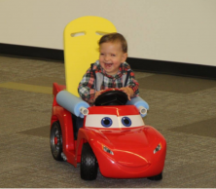
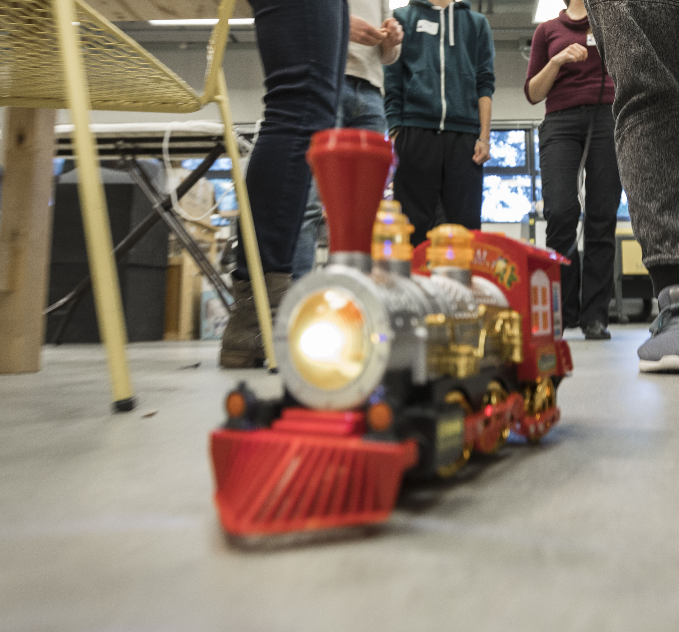
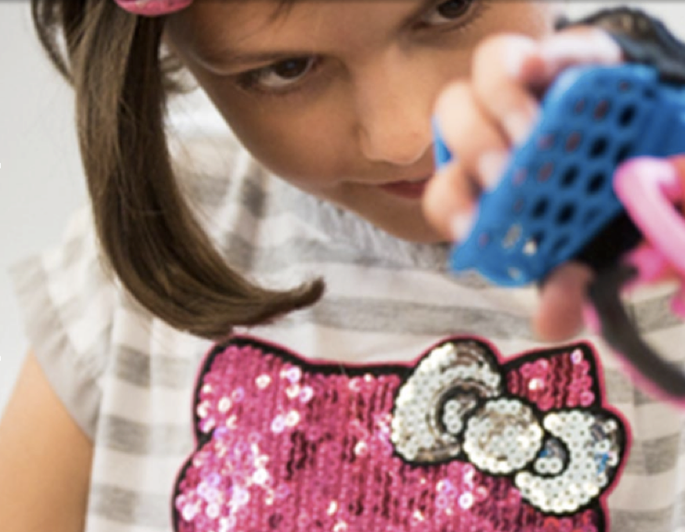
What is HuskyADAPT?
Go Baby Go
Toy Adaptation
Design
Inglemoor high school senior design class
Modified 6 cars based off of individual case studies
Adapted 224 toys
Taught 348 people toy adaptation
Launched an open source library for adaptable toys
Created 19 design teams
Presented work at multiple design fairs

Slide 3
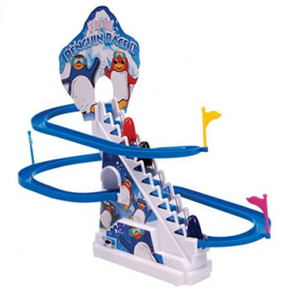
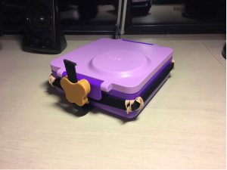
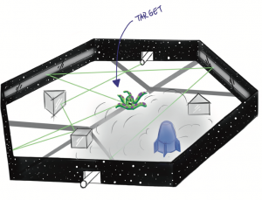
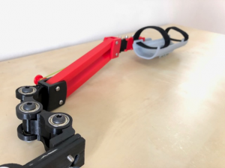
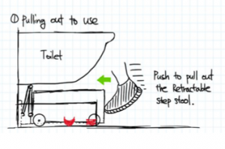
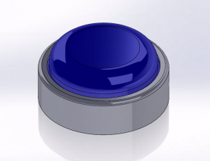
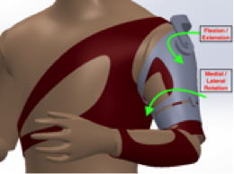
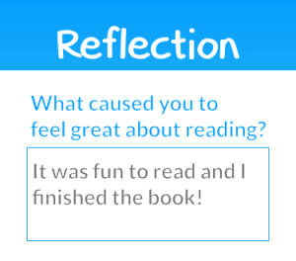
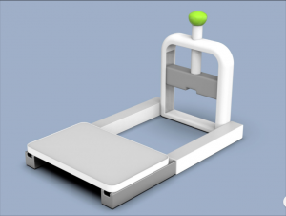
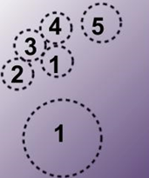
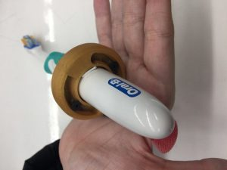
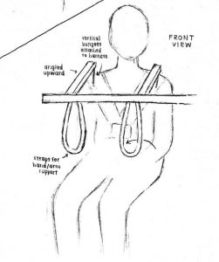
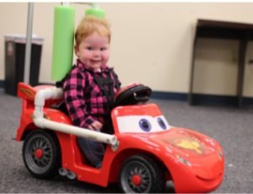
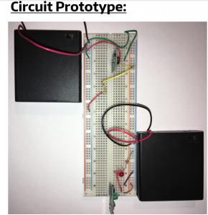
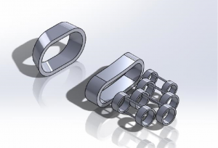
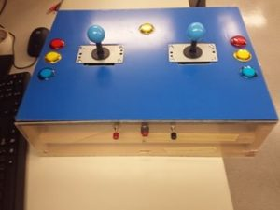
Design Projects

Slide 4
How can we make HuskyADAPT a sustainable program?

Slide 5
How can we make HuskyADAPT a sustainable program?
Aim
1
Develop an online database storing all documentation from design projects enabling others to explore, download and iterate upon our work

Slide 6
How can we make HuskyADAPT a sustainable program?
Aim
1
Develop an online database storing all documentation from design projects enabling others to explore, download and iterate upon our work
Aim
Develop an optimized and replicable process for creating the design challenges for upcoming years
2

Slide 7
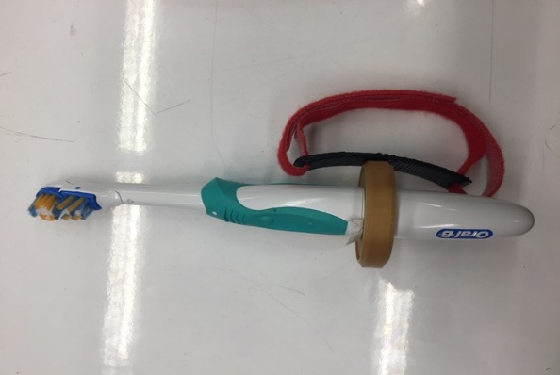
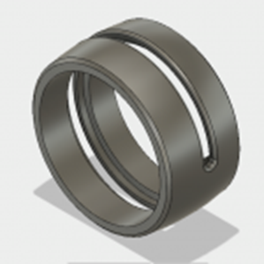
Furthering a Design Project
How can we help individuals with limited hand function perform daily hygienic tasks?
Built upon the work performed by Team Cajun
Created a modular tool that enables user to effectively manipulate a variety of objects
Rotates toothbrush to users needs
360 degrees laterally
270 degrees axially

Slide 8
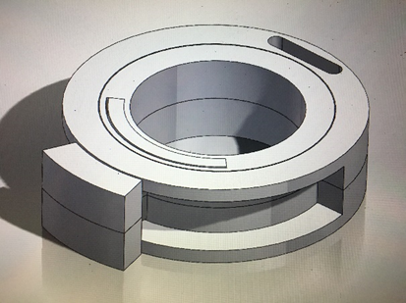
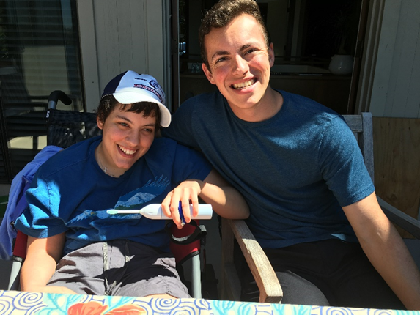
Furthering a Design Project
Outcome
Designed a tool specifically for need expert Erin Ciliv
A need expert is a community member who provides invaluable insight on a particular disability
Iterated through multiple prototypes based off of user feedback
Device builds upon Erin’s ability with her left hand
Future
Implement attachment to act as a button
Modify toothbrush stand

Slide 9
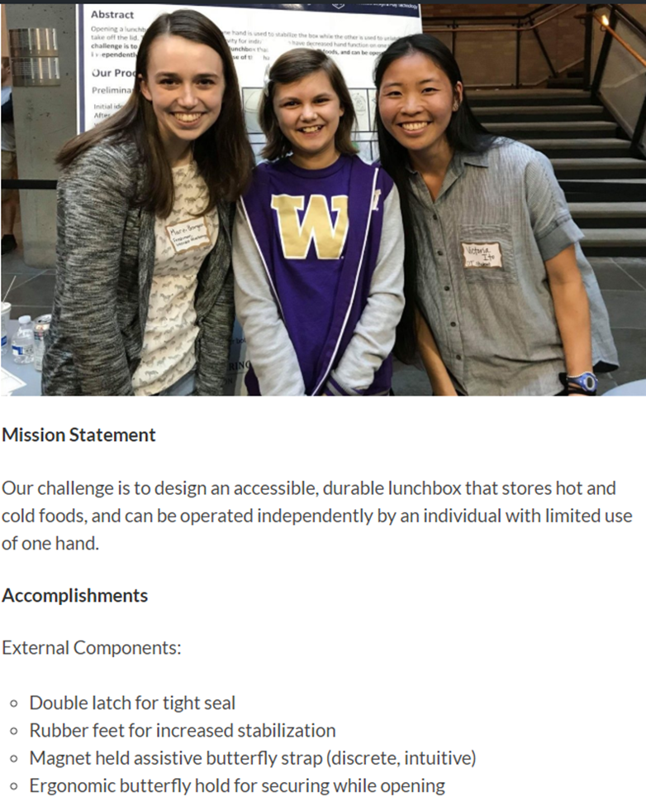
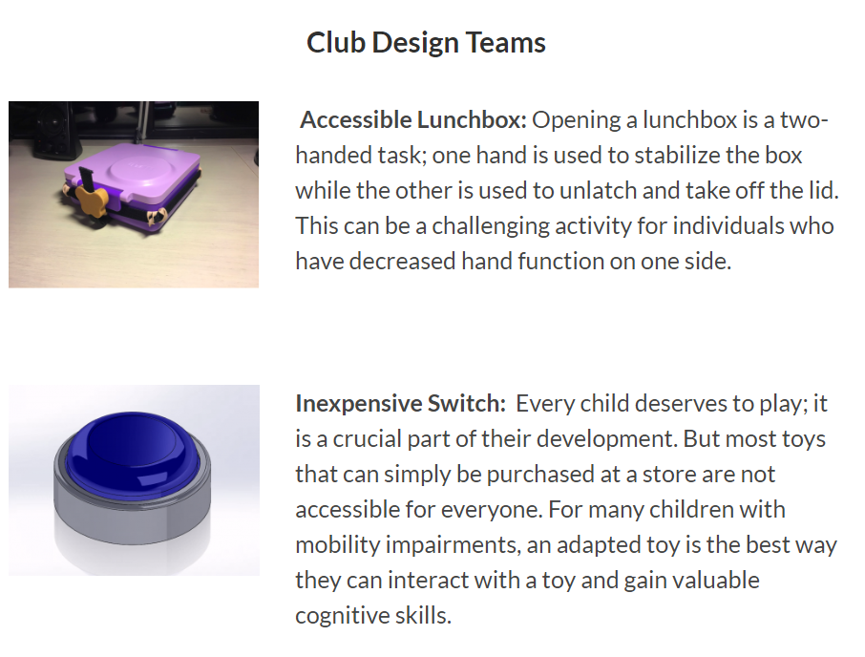
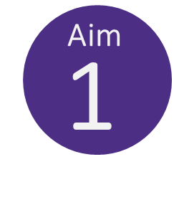
Design Projects 2017-2018
Created a website showcasing all past and ongoing projects
Ensures others may explore and iterate upon our work
Incorporated accessibility features
Alternative text, screen reader compatible

Slide 10
Design Projects 2017-2018
Created a website showcasing all past and ongoing projects
Ensures others may explore and iterate upon our work
Incorporated accessibility features
Alternative text, screen reader compatible

Slide 11
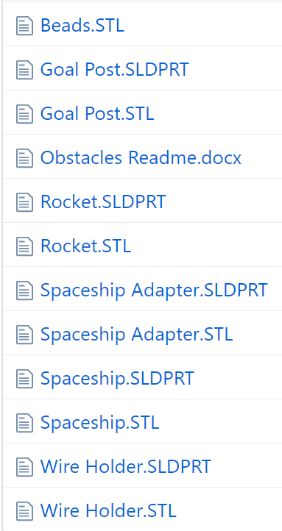
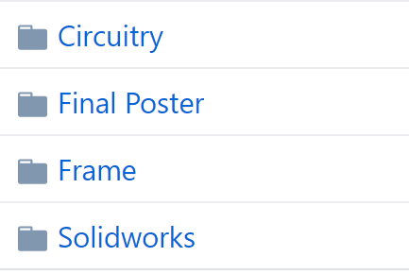
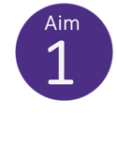
Design Projects 2017-2018
Provides access to GitHub repository of documentation
Community can get a first hand look at the design process
Able to utilize our designs by downloading CAD files

Slide 12
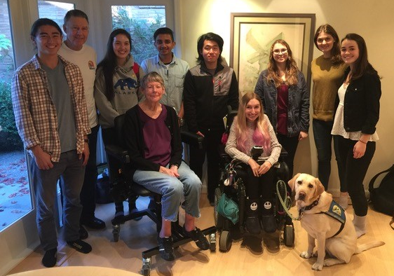
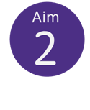
Design Challenges 2018-2019
Outcome
Modified survey sent out to need experts
Centralized repository of community members contact information
Created an interview document for meetings with need experts
Future
One page summary of each design challenge

Slide 13
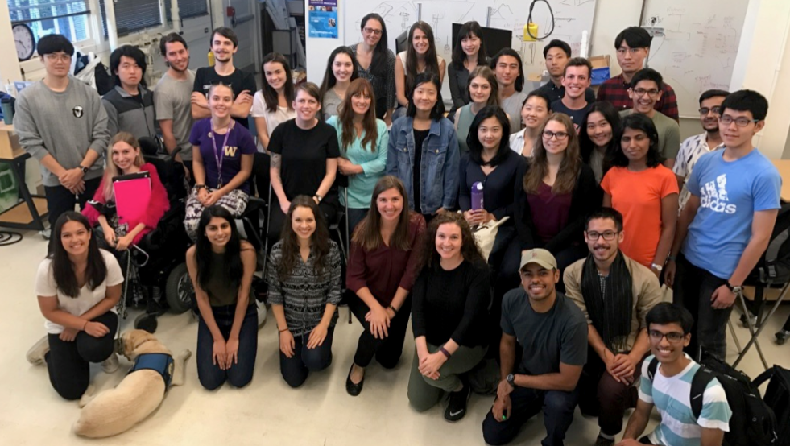
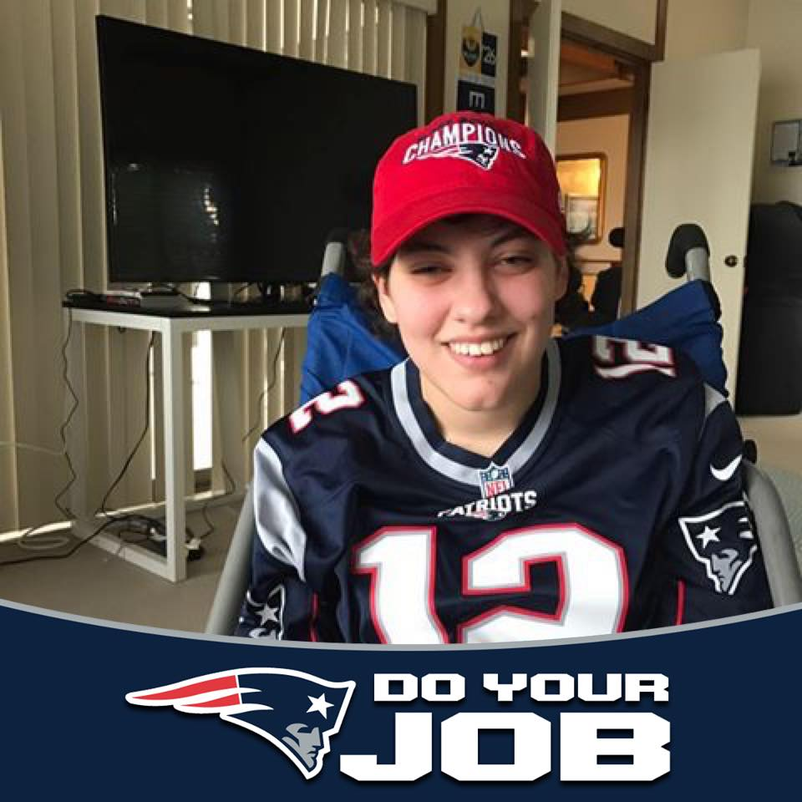
Future of HuskyADAPT

Slide 14



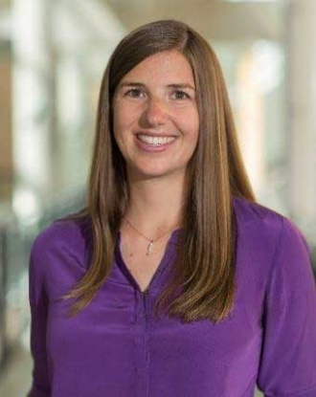
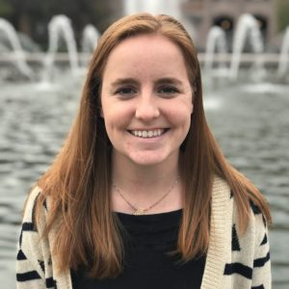
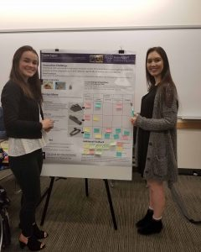
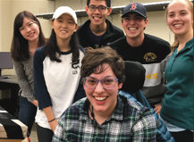
Acknowledgements
University of Washington, Ability and Innovation lab
Team Cajun
Keshia Peters
Alyssa Spomer
Kat Steele, PhD
Need Expert
Erin Ciliv

Slide 15
Thank you!
Questions?

